Slide 1
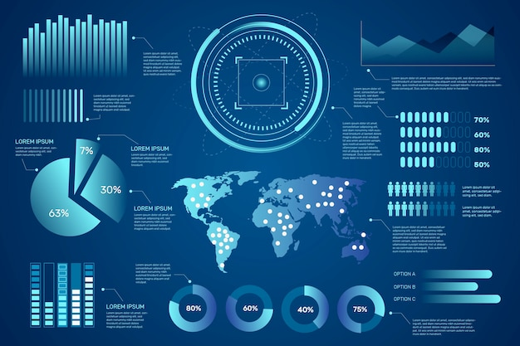

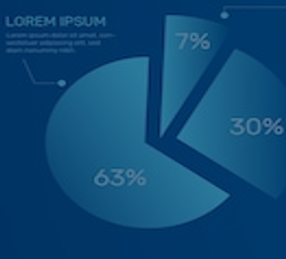
DSA5400
Visual Data Exploration
Module 3: Intro to Plotting & Tableau
Michael Dupin, Ph.D.

Slide 2
Course Roadmap & Assignments
Week 1 | Week 2 | Week 3 | Week 4 | Week 5 | Week 6 | Week 7 | Week 8
Course learning objectives Data, information, and knowledge Intro to data visualization | Data as a competitive advantage CRISP framework Human perception and cognition | Data types Intro to ML Grammar of graphics | EDA process ggplot2 (Grammar of graphics continued) | Diagnosis and treatments Special cases: time, space, and clusters | Segmentation R Shiny | Segmentation and profiling Tableau and other dashboards | Course wrap-up Tableau
Introduction | Position Paper #1 | Position Paper #2 | Data Due Diligence Project |  | Segmentation and Profiling Project
Quiz 01 | Quiz 02 | Quiz 03 | Quiz 04 | Quiz 05 | Quiz 06 | Quiz 07 | Quiz 08

Slide 3
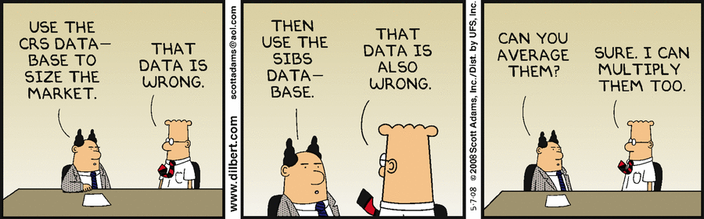

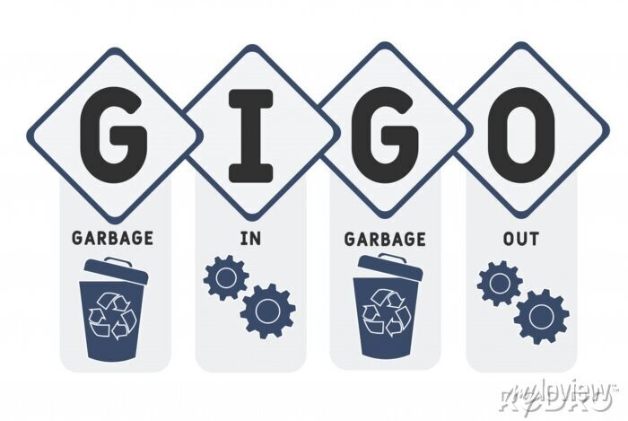
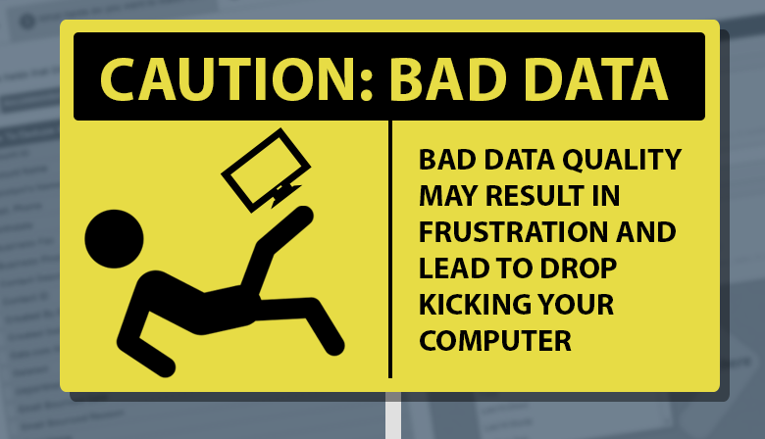
Position Paper #2 Overview
Position Paper #2
Given the general explosion of interest in data analytics, perhaps no area of data science has received more attention than predictive modeling. As a result, building predictive models is often among the core responsibilities of data scientists. Unfortunately, data quality can be a huge obstacle to successful predictive modeling projects.
In this position paper, present:
What data-quality-related challenges you have encountered in your experience or in general applications?
How visual (qualitative) and statistical (quantitative) methods were used/could have been used to expose these problems?
What were/could have been the possible remedies?
Be explicit (i.e., fully explain and justify your points) in your explanation. Use and cite resources!
Format: No more than 2 single-spaced page in PDFed Word | Calibri, 10-pt font throughout, cite your work.
Avoid monolithic essays: use formatting, sections, illustrations if applicable, etc.

Slide 4

Live Programming Catch up Session 2

Slide 5
Data Basics
Let’s move towards Visualization

Slide 6
Classifications of Data
Quantitative vs. Qualitative
Quantitative – Data defined using objective numerical measures
Retail transactions;
Bank account in flow-out flow and balance
Stock market data;
Healthcare claims data
Qualitative – Starting point of data is collected and defined using non-numerical or subjective content
User generated content – X / Facebook
Product reviews on shopping websites by consumers
Call logs
Images
Root vs. Derived
Root: Data in its raw atomic form vs. recoded, merged and joined;
Derived: calculated, aggregated in some form or the other
Root | Derived
Age in years | Age cohorts
# of customers in a ZIP code and # of population in a ZIP code | Customer penetration by ZIP
# email send and # email open | Email open rate
4

Slide 7
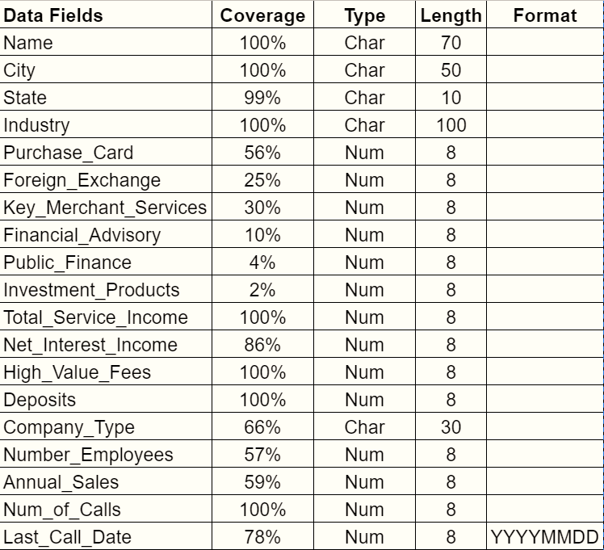
Various Types of Data
Root Data
Derived Data
Derived Data Joined from other Tables
Note: Derived data fields are usually more informative and provide higher competitive advantage

Slide 8
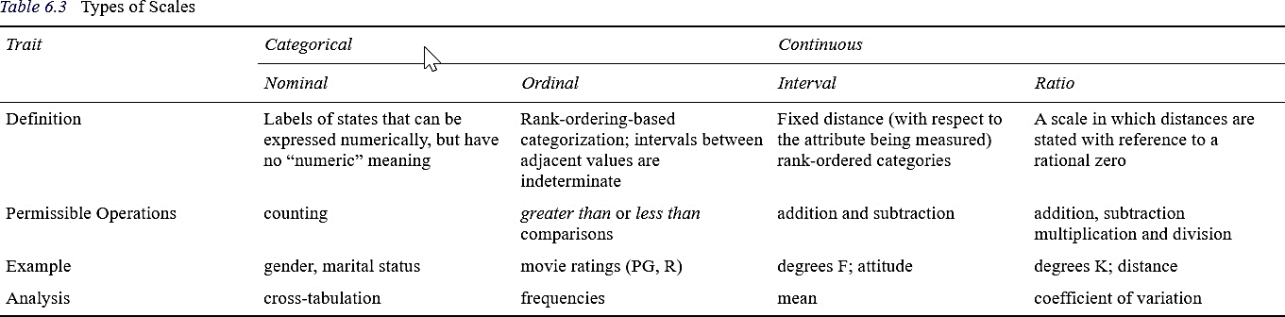



Measurement scales for variables or fields
Different types of variables require different visualizations:
Other useful ratios:
All potential inputs for Predictive Models
Categorical variables need to be recoded to numeric variables for modeling
Open rate
Click rate
Click to open rate
Customer and product penetration in a ZIP code
Competitor concentration in a
ZIP code
% of population 65 or older in a ZIP code

Slide 9
Intro to Machine Learning
Or is it Artificial Intelligence?

Slide 10
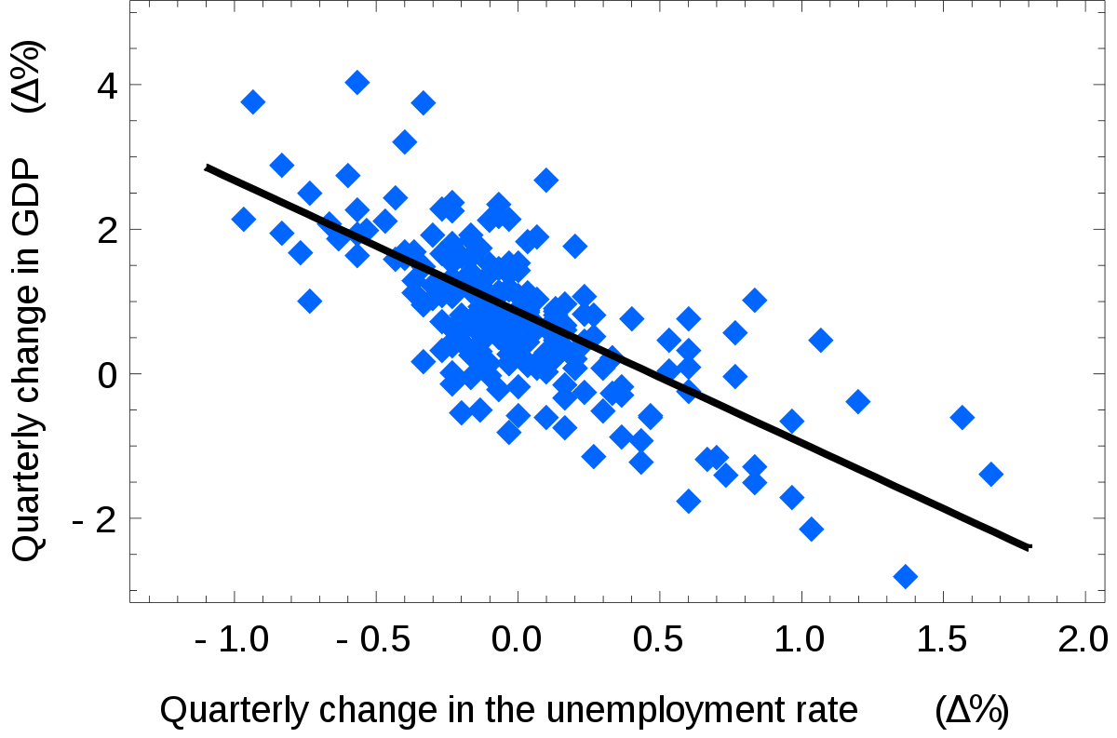
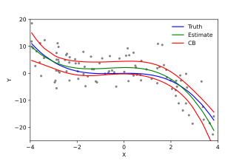
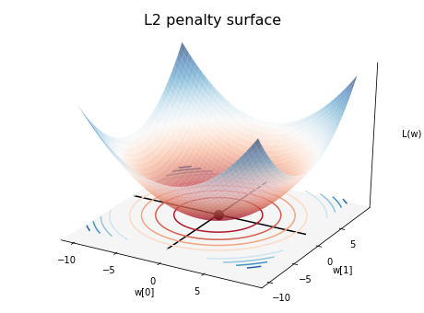
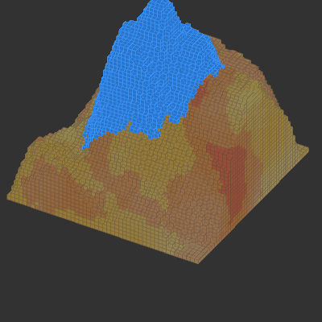
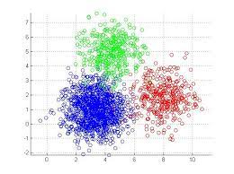
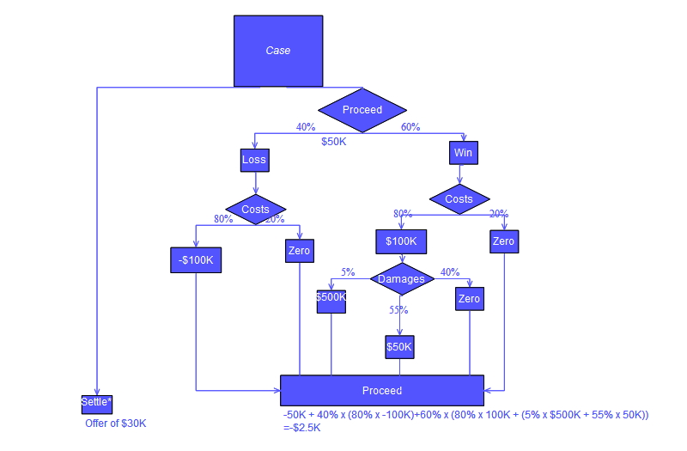
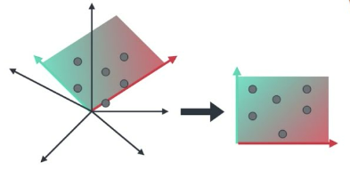
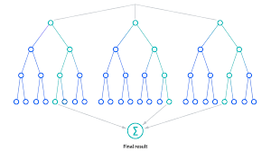
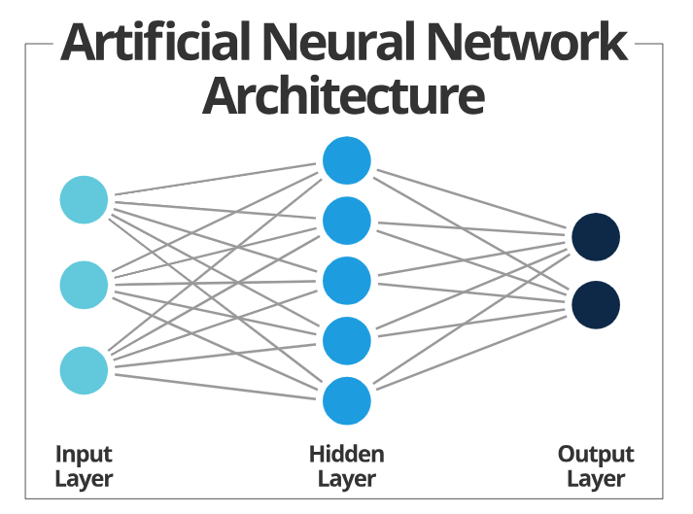
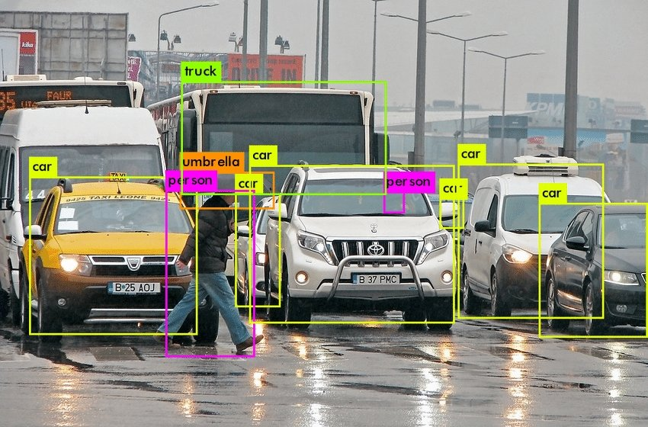
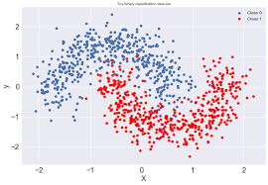
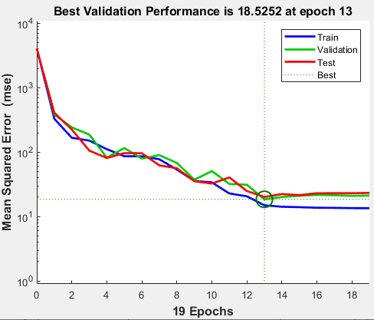


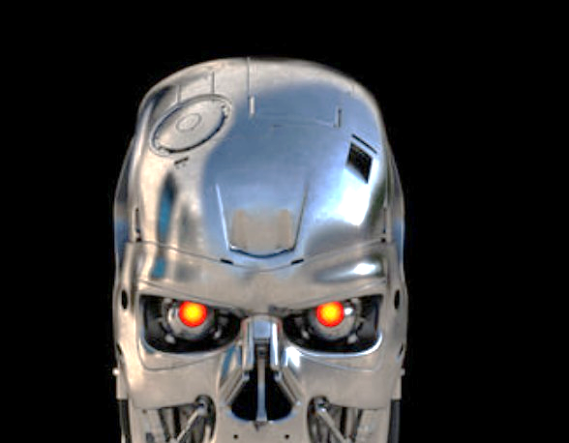
Artificial Intelligence, Machine Learning, Deep Learning, etc.
Artificial Intelligence (A.I.)
Machine Learning (M.L.)
Neural Networks
Deep learning
Generative Models
Artificial General Intelligence

Slide 11


Machine Learning Value Chain – From Lab to Production
Laboratory Analytics: Offline, Batch
Factory Analytics: Online, Real Time
Understand Business Problem
Analytic Plan & Approach
Data Ingestion Plan
Model(s) Development: Initial & Challenger
Model(s) Testing
Test & Measurement Plan
Data Ingestion
Model Deployment
Decision Engine & Channel integration
Performance Monitoring
Performance Tuning

Slide 12



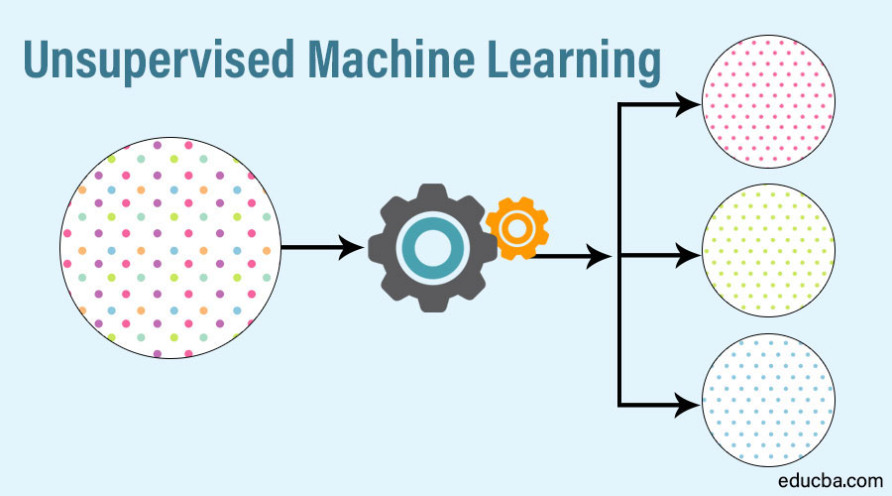





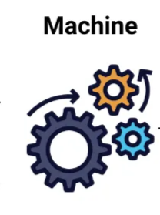
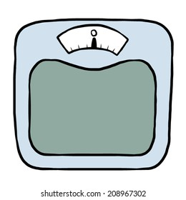

Supervised vs. Unsupervised Learning
Supervised Learning
Unsupervised Learning
Algorithm is trained on the data to find the relationship between the input variables (independent variables) and the output (dependent variable)
Unknown classification of the data, and you want the algorithm to find patterns and classify the data for you.
Common techniques: linear regression, logistic regression, decision trees, naïve Bayes’, random forest, SVM, etc.
Common techniques: k-means clustering, hierarchical clustering, gaussian mixture model
Notes:
Examples of supervised learning algorithms: Examples of unsupervised learning algorithms:

Slide 13
Grammar of Graphics
How can you create visualizations using Grammar of Graphics

Slide 14
Grammar of Graphics
R
ggplot2 - https://ggplot2.tidyverse.org/
plotly - https://plotly.com/ggplot2/getting-started/
Python
seaborn - https://seaborn.pydata.org/
plotly - https://plotly.com/
plotnine - https://plotnine.readthedocs.io/en/stable/
altair - https://altair-viz.github.io/
Language agnostic
vega - https://vega.github.io/vega/
vega-lite - http://vega.github.io/vega-lite/
The grammar of graphics presents a consistent cookbook to create plots and charts in many different systems.
This system gives us the formal terminology to describe and recreate any plot.
Notes:
Note: If the physics of the environment of interest are known, you can apply the algorithm to a simulated environment

Slide 15
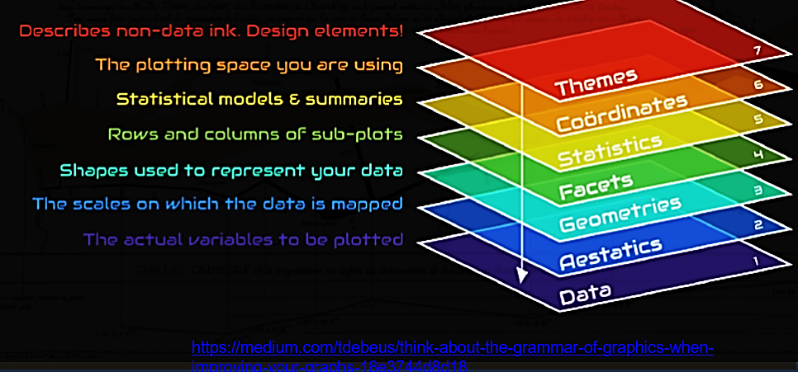
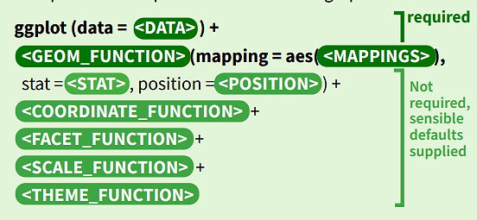
Grammar of Graphics
The idea is that any basic plot can be built out of a combination of:
Necessary
a data set;
one or more geometrical representation (geoms);
mappings of values to aesthetic features of the geom;
Optional
a stat to produce values to be mapped;
position adjustments;
a coordinate system;
a scale specification;
a faceting scheme.
https://medium.com/tdebeus/think-about-the-grammar-of-graphics-when-improving-your-graphs-18e3744d8d18
Notes:
Note: If the physics of the environment of interest are known, you can apply the algorithm to a simulated environment

Slide 16
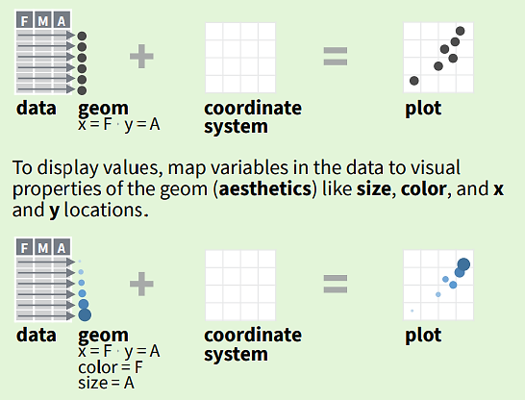
Grammar of Graphics - Data
In basic usage:
Data can take any form you wish (within a dataframe table, usually)
Columns reflect values to be plotted, groupings, or labels.
Rows reflect examples
Data can be manipulated within the plot - using stat transformations (see histograms, smoothing, or bar charts)
Notes:
Note: If the physics of the environment of interest are known, you can apply the algorithm to a simulated environment

Slide 17
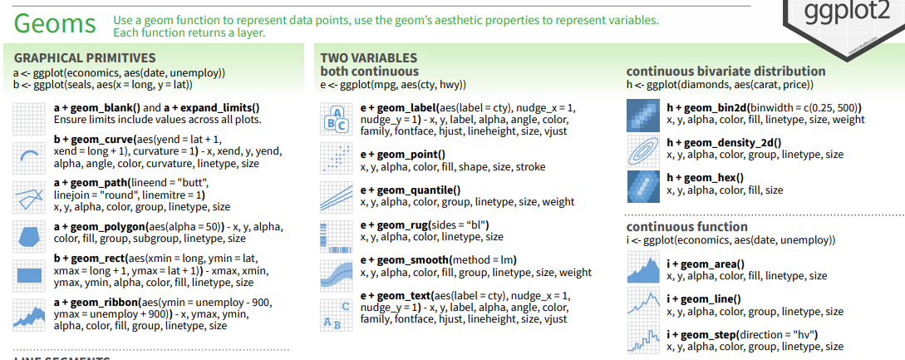
Grammar of Graphics - Geom
Geoms represent the type of graph you trying to create.
https://ggplot2.tidyverse.org/reference/
Notes:
Note: If the physics of the environment of interest are known, you can apply the algorithm to a simulated environment

Slide 18
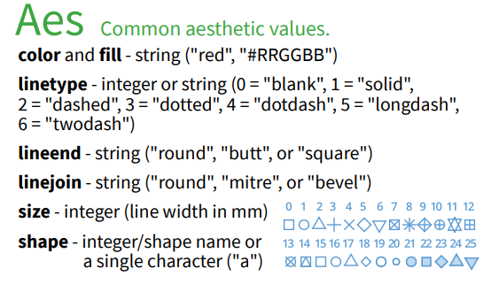
Grammar of Graphics - Aesthetics
The appearance of geom objects is controlled by aesthetic features.
Each geom has some required and some optional aesthetics.
Example
For a scatterplot, the required aesthetics are
x-axis column
y-axis column.
For a histogram, the required aesthetics would just be
x-axis column
Optional aesthetics include
color
fill
shape
size
Notes:
Note: If the physics of the environment of interest are known, you can apply the algorithm to a simulated environment

Slide 19
Grammar of Graphics - Question 1
Here is some data…. Let’s do some Viz! (Cars_engines_performance.xlsx)
Notes:
Note: If the physics of the environment of interest are known, you can apply the algorithm to a simulated environment

Slide 20

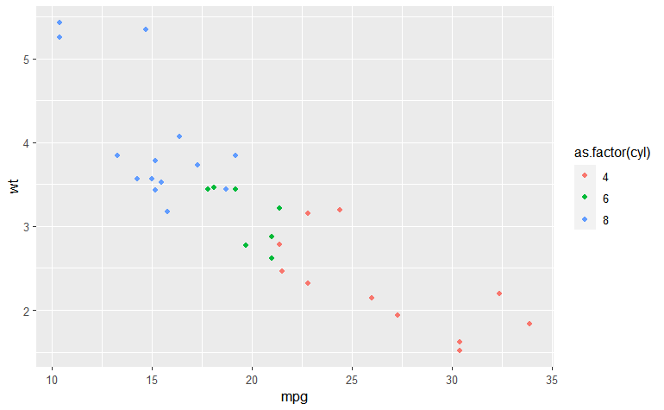
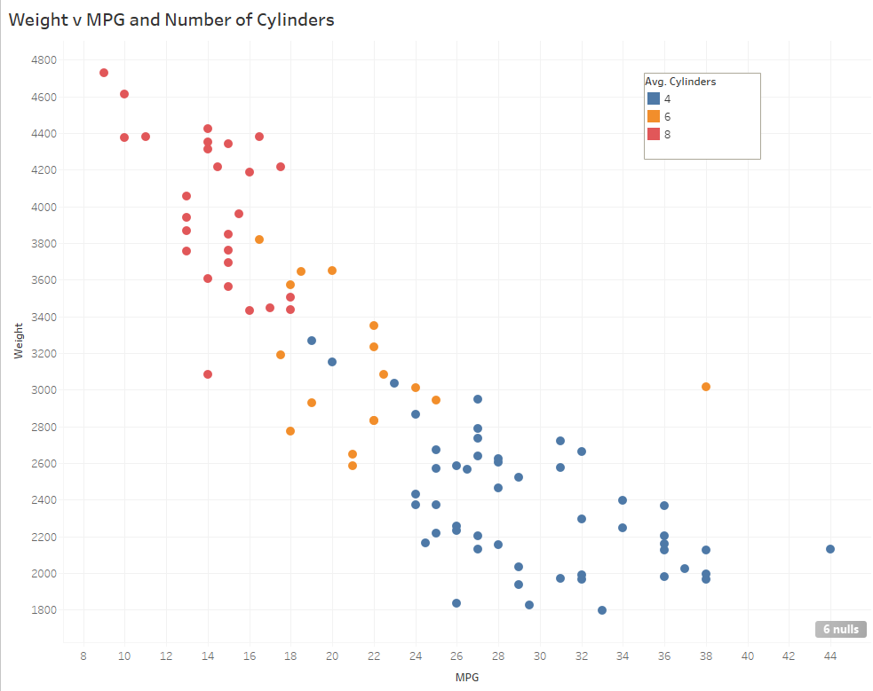

Grammar of Graphics - Question 1
What do you think this specification shows?
Geom:
geom_point
Aes:
x =
mpg
y =
weight
color =
# of cylinders
Notes:
Note: If the physics of the environment of interest are known, you can apply the algorithm to a simulated environment

Slide 21
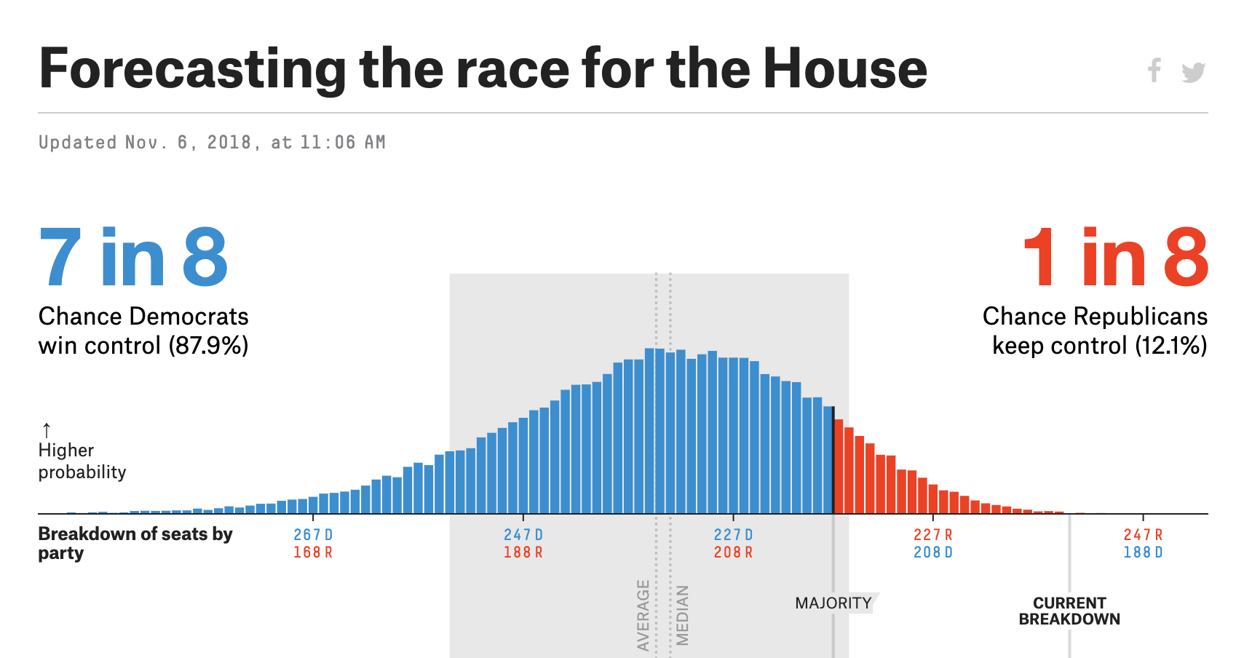
Grammar of Graphics - Question 3
What are key elements for this plot?
What type of data is considered?
Nominal data (Republican/Democrats win) Simulated election results
What type of representations are introduced?
Histogram (of seats won)
Ordinal (% chance Democrats win)
What aesthetics do you notice?
Grey shape (Confidence interval)
x-axis by number of seat won
Democrats in blue, Republicans in red
Use of conventions (democrats in blue, republicans in red)
Grey font in “updated”, “average”/”Median”
Simple Stand-out elements (“x in y”)
3 different fonts
Notes:
Note: If the physics of the environment of interest are known, you can apply the algorithm to a simulated environment

Slide 22

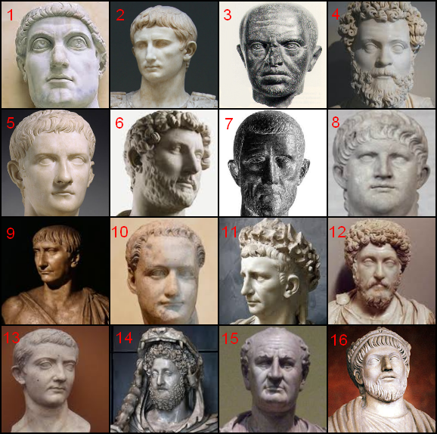
Module 03: Optional Segmentation Case Study
Notes:
Note: If the physics of the environment of interest are known, you can apply the algorithm to a simulated environment

Slide 23

Live Programming
Let’s go!

